Slide 1
Detecting AI Generated Fake-Media
Under the Guidance of : Dr. Nilesh Bhelkar
Prepared by:
Chaturdhan Chaubey (802)
Mahesh Gaikwad (809)
Vishal Gawali (832)
Akash Gidde (842)

Slide 2
Abstract
The rapid growth of AI-generated images, particularly through techniques like Generative Adversarial Networks (GANs), has made it increasingly difficult to distinguish between authentic and synthetic content. This challenge is critical in maintaining the integrity of visual media, where traditional methods often fall short.
The detection techniques, focusing on machine learning models and deep learning-based model such as convolutional neural networks (CNNs). The methods are designed to uncover subtle artifacts and inconsistencies in images, such as anomalies in pixel distribution and lighting, which are key indicators of AI generation.
The study highlights the need for continuous innovation in detection technologies to keep pace with rapidly advancing AI capabilities. Ensuring the accuracy and reliability of these detection methods is essential for safeguarding against misinformation and preserving trust in digital content. Hence we are proposing this Deepfake detection system.

Slide 3
Introduction
The advancement of artificial intelligence has led to amazing developments, but it has also enabled the creation of fake media, such as deepfakes and synthetic images, that are so realistic they can easily fool people. This makes it increasingly difficult to distinguish between what’s real and what’s fake, which can cause serious issues like spreading misinformation, deceiving the public, and manipulating opinions
Convolutional Neural Networks (CNNs) are fundamental to image recognition tasks, evolving from simple models like LeNet5 to more sophisticated ones like ResNets and DenseNets, which address challenges like vanishing gradients through improved information flow and reduced overfitting.
The rise of image manipulation techniques, such as Deepfakes, has resulted in hyper-realistic fake images, raising significant concerns about misinformation. In response, current research is focused on detecting these AI-generated fakes by identifying inconsistencies or using machine learning and deep learning models to differentiate between real and fake images.

Slide 4
Literature survey
AUTHOR | YEAR | TOPIC | RESULT | RESEARCH GAP
Xin Yang , Yuezun Li and Siwei Lyu | 2019 | Exposing Deepfakes Using Inconsistent Head Poses | High AUROC Scores: The models report high Area Under the Receiver Operating Characteristic (AUROC) scores, reflecting strong classification performance. Significance of Head Pose Differences: The findings suggest that differences in head poses estimated from the central region of the face, compared to the whole face, are significant features for identifying deepfakes. | Handling Low-Quality Images: There is a need for improved techniques to handle low-quality images, as current methods struggle with such data. Generalization of Detection Methods: There is a lack of understanding of how well existing detection methods generalize across different datasets and types of deepfakes, highlighting the need for more robust and adaptable approaches.
Hao Dan FengLiu Joel Stehouwer Xiaoming Liu Anil Jain | 2020 | On the Detection of Digital Face Manipulation | Use of Attention Mechanism: The proposed method incorporates an attention mechanism to enhance detection and localization of manipulated facial images. Low False Detection Rate: It particularly excels in scenarios with low false detection rates. | Diverse Datasets Requirement: More diverse datasets are required to better address the challenges posed by different types of face manipulation Need for Robust Evaluation Metrics: There is a need for more robust evaluation metrics to effectively assess the performance of detection models against various face manipulation attacks.

Slide 5
AUTHOR | YEAR | TOPIC | RESULT | RESEARCH GAP
Falko Matern Christian Riess Marc Stamminger | 2019 | Exploiting Visual Artifacts to Expose Deepfakes and Face Manipulations. | k-NN Classifier Performance: The k-NN classifiers achieved an AUC of 0.852 on GAN data with good segmentation. Logistic Regression on Face2Face: Logistic regression performed well on the Face2Face dataset, indicating that simpler models can be effective. | Enhanced Iris Segmentation: There is a need to develop advanced methods for detecting subtle visual manipulations. Improvement of Face2Face Datasets: Further investigation is required into the use of more complex models and the employment of larger dataset. Advanced Deepfake Classification: There is a critical need to explore and develop new classification techniques and algorithms that can adapt to the rapidly evolving methods used in Deepfake manipulations.
Laurens van der Maaten, Zhuang Liu, Gao Huang | 2019 | Densely Connected Convolutional Networks | DenseNets Efficiency in Parameters: DenseNets, with their dense connectivity patterns, require significantly fewer parameters than traditional convolutional networks like ResNets. Comparable Performance: Despite using fewer parameters, DenseNets achieve performance comparable to ResNets. Efficiency in Computation: A DenseNet with the same computational requirements as a ResNet-50 performs on par with a ResNet-101, which requires twice the computation. | Scalability of DenseNets: Current research lacks comprehensive analysis of DenseNet’s scalability. Impact of Architectural Variations: There is insufficient exploration of how different architectural variations within DenseNet models affect their performance. Hyperparameter Settings: The effects of different hyperparameter configurations on DenseNets' performance are not well-understood.

Slide 6
AUTHOR | YEAR | TOPIC | RESULT | RESEARCH GAP
Md. Shohel Rana , Andrew H. Sung | 2020 | DeepfakeStack: A Deep Ensemble-based Learning Technique for Deepfake Detection | Accuracy: DeepfakeStack achieved high accuracy of 99.65% in detecting Deepfake videos. AUROC Score: DeepfakeStack obtained a perfect AUROC score of 1.0, surpassing the performance of individual deep learning models. | Computational Efficiency: Existing models, such as DeepfakeStack (DFC), face challenges with high computational time, and the development of more efficient solutions. Overfitting Prevention: Large models like DeepfakeStack (DFC) are prone to overfitting; thus, methods to prevent overfitting while managing model size are required.

Slide 7
Existing System
Here are the key details about the existing system:
1. Overall Framework
Deepfake detection frameworks generally combine visual analysis to identify manipulated content. They involve steps like preprocessing to enhance data quality, feature extraction to identify anomalies, and classification to determine if content is altered. These frameworks aim to handle large data volumes and adapt to various manipulation techniques by integrating traditional computer vision method.
2. Machine Learning and Deep Learning Algorithms
Convolutional Neural Networks (CNNs): Widely used for detecting visual inconsistencies and artifacts in images and videos due to their ability to learn spatial hierarchies and patterns.
K-Nearest Neighbors (KNN): A non-parametric algorithm used for classification by comparing the input to 'k' similar labeled images, assigning the most common label among them.
3. Objectives
The primary goals are to accurately detect manipulated images/videos and localize altered regions, achieving high classification performance and enhancing explainability. The system is designed for adaptability, capable of real-time applications, and improving detection robustness through attention-based insights.

Slide 8
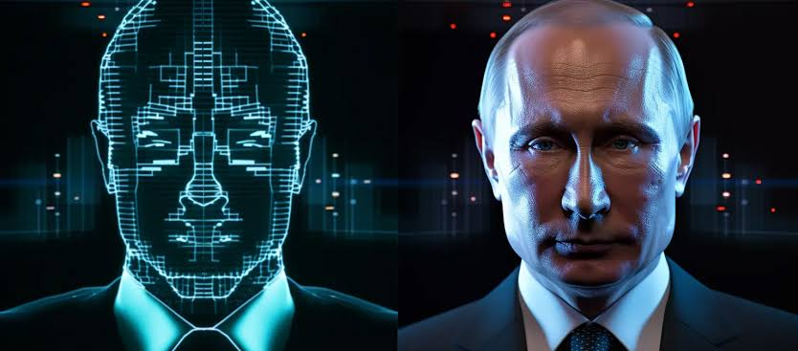
Problem statement
Deepfake detection has become a critical challenge in the digital age due to the increasing sophistication of deep learning techniques. The ability to manipulate and generate highly realistic synthetic media, such as videos and images, poses a significant threat to various domains.

Slide 9
Proposed system
Overview of the Proposed system:-
1. DeepfakeStack Technique
A deep ensemble learning technique designed to detect deepfake images.
Combines several state-of-the-art deep learning-based classifiers into a single composite classifier for improved accuracy.
2. Architecture
Consists of base-learners known as level-0 models.
Base-learner consist of MobilenetV2 and InceptionV3.
Uses a meta-learner, also known as Deepfake Classifier (DFC), as the level-1 model to combine predictions from the base-learners.
As for meta-learner we used simple CNN model.
3. Model Training
The predictions from these base-learners are then used as input to train the meta-learner.
The meta-learners are trained using out-of-sample data, meaning data not used during the training phase.

Slide 10
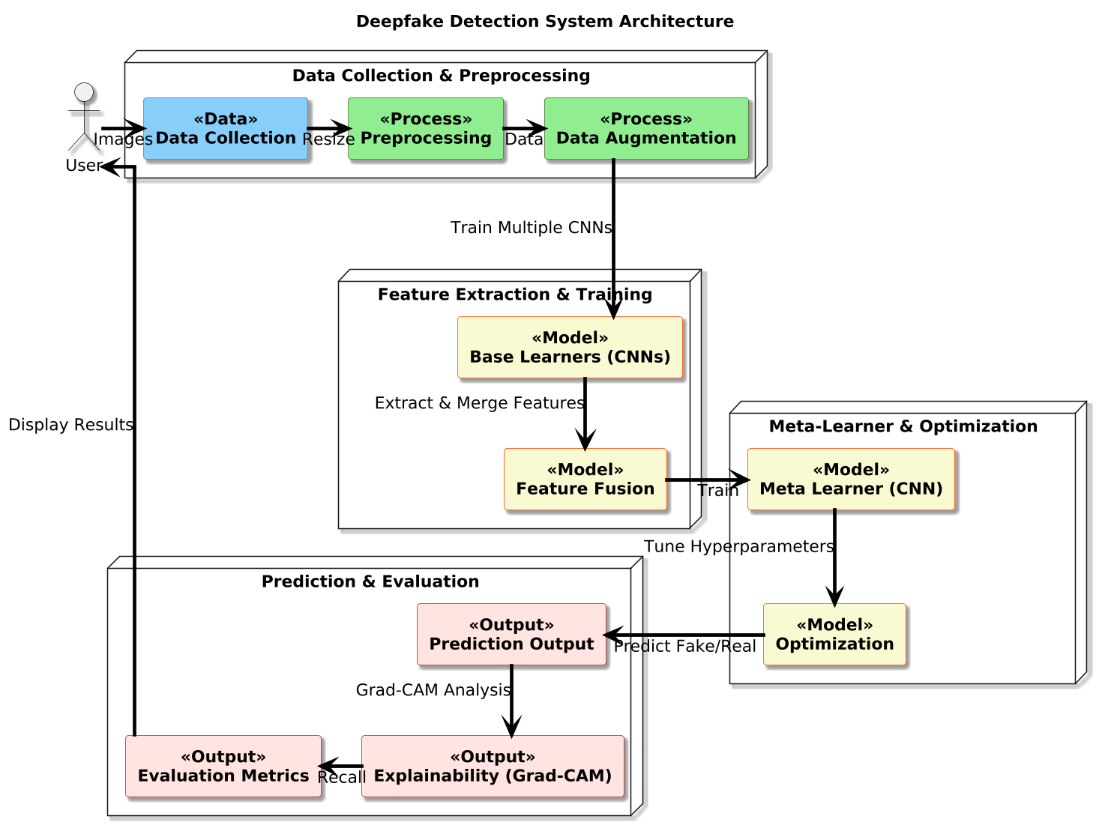
System Architecture

Slide 11
List of algorithms
XceptionNet:
Stands for "Extreme Inception."
Uses depth wise separable convolutions for efficient computation.
Specializes in capturing complex spatial features.
ResNet (Residual Networks):
Introduced the concept of residual learning to solve the vanishing gradient problem.
Enables the training of very deep networks.
Known for its skip connections that improve performance and convergence.
InceptionResNet:
Combines the strengths of Inception architecture with ResNet’s skip connections.
Offers efficient feature extraction with enhanced accuracy.
Balances depth and computational efficiency.

Slide 12
List of algorithms
MobileNet:
Designed for lightweight applications and mobile devices.
Utilizes depth wise separable convolutions to reduce computational costs.
Excellent for edge-device applications requiring low latency.
Inception:
Employs multi-scale feature extraction by using inception modules.
Extracts diverse spatial features at multiple scales simultaneously.
Optimized for both performance and efficiency.
DenseNet (Densely Connected Convolutional Networks):
Ensures direct connections between each layer and all subsequent layers.
Promotes feature reuse, reducing the number of parameters.
Achieves state-of-the-art performance in deep learning tasks.

Slide 13
Finalised algorithms
Inception:
Effective for extracting detailed spatial features from complex datasets like deepfake images.
Balances computational efficiency with high accuracy.
MobileNet:
Optimized for lightweight computation using depthwise separable convolutions.
Significantly reduces the number of parameters and computation. Ensures fast inference while maintaining reliable accuracy, making it practical for real-time deepfake detection.
CNN :
CNNs excel at learning complex patterns and relationships in high-dimensional feature spaces.
Aggregates and processes features extracted by base learners (Inception and MobileNet).
Enhances the overall model’s ability to generalize and detect subtle patterns in deepfake datasets.

Slide 14
METHODOLOGY
Data Collection: We are gathering the Fake-Vs-Real-Faces (Hard) Dataset from Kaggle.
Data Preprocessing: Detected and cropped faces from input images using tools like MTCNN to focus only on facial regions. Converted the data into tensors and normalized pixel values to a range of [0, 1].
Base Learner Creation: Created multiple deep learning models known as base learners using different algorithms or techniques. These models are trained independently on the same data to learn various aspects of the data.
InceptionV3: Leveraged its capability to extract hierarchical spatial features.
MobileNet: Chosen for its lightweight architecture and efficiency in computationally constrained environments.
Meta Learner Creation :
Stack Generalization Approach: Outputs of InceptionV3 and MobileNet were combined as inputs to the meta-learner.
Meta-Learner Model : Implemented a CNN to weigh and aggregate predictions from the base learners.
Stacking Framework : Used a two-layer stacking ensemble to increase robustness and reduce overfitting.

Slide 15
METHODOLOGY
Evaluation: Assess the performance of the ensemble model using metrics.
Metrics Used:
Accuracy: Percentage of correct predictions.
AUROC: Evaluated the model's performance at distinguishing between classes.
Precision: Fraction of true positives among predicted positives.
Recall: Fraction of true positives detected by the model.
F1-Score: Harmonic mean of precision and recall.
Performance Analysis: Achieved a high AUROC score and F1-Score indicating strong detection capabilities across both classes.
Validation: Validated the model on unseen test data and conducted a cross-validation process to ensure consistency.
Deployment:
Frontend Integration: Integrated the API with a Gradio web application for user-friendly interaction.
Input Format: Accepted user-uploaded images files for prediction.
Output: Displayed a clear classification of "real" or "fake" with associated probabilities.

Slide 16
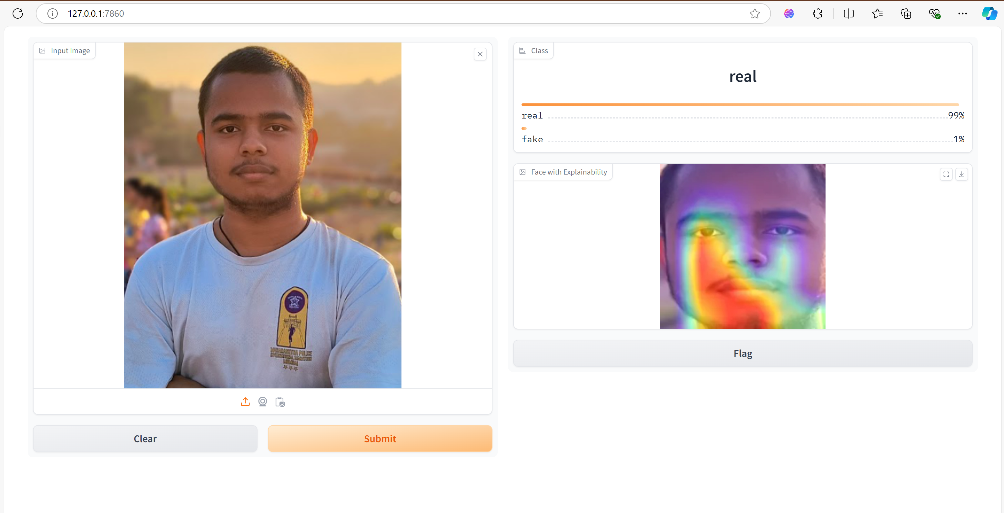
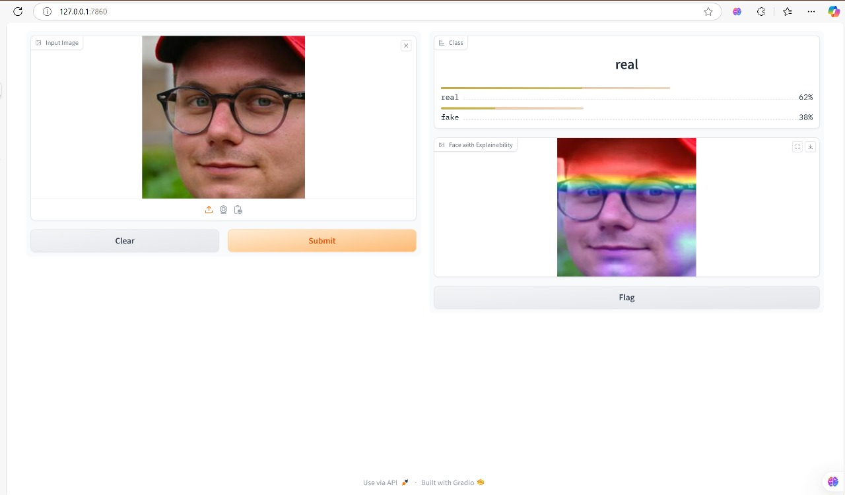
Result

Slide 17
System Requirements
Hardware Requirements:
CPU: Quad-core processor.
GPU: RTX 1050 or at least Intel IrisXe.
RAM: Minimum 16 GB recommended.
Storage: SSD with at least 50 GB free.
Software Requirements:
Operating System: Windows 10/Linux/macOS.
Programming Language: Python 3.7+.
Libraries: TensorFlow, Keras, scikit-learn, joblib, matplotlib, Numpy, seaborn, Pandas etc.
IDE: Jupyter Notebook/VSCode/PyCharm.

Slide 18
References
F. Matern, C. Riess, and M. Stamminger, ‘‘Exploiting visual artifacts to expose deepfakes and face manipulations,’’ in Proc. IEEE Winter Appl. Comput. Vis. Workshops (WACVW), Waikoloa Village, HI, USA, Jan. 2019, pp. 83–92, doi: 10.1109/WACVW.2019.00020.
X. Yang, Y. Li, and S. Lyu, ‘‘Exposing deep fakes using inconsistent head poses,’’ in Proc. IEEE Int. Conf. Acoust., Speech Signal Process. (ICASSP), Brighton, U.K., May 2019, pp. 8261–8265, doi: 10.1109/ICASSP.2019.8683164.
G. Huang, Z. Liu, L. Van Der Maaten, and K. Q. Weinberger, ‘‘Densely connected convolutional networks,’’ in Proc. IEEE Conf. Comput. Vis. Pattern Recognit. (CVPR), Honolulu, HI, USA, Jul. 2019, pp. 2261–2269, doi: 10.1109/CVPR.2017.243
M. S. Rana and A. H. Sung, ‘‘DeepfakeStack: A deep ensemble-based learning technique for deepfake detection,’’ in Proc. 7th IEEE Int. Conf. Cyber Secur. Cloud Comput. (CSCloud)/6th IEEE Int. Conf. Edge Comput. Scalable Cloud (EdgeCom), New York, NY, USA, Aug. 2020, pp. 70–75, doi: 10.1109/CSCloud-EdgeCom49738.2020.00021
H. Dang, F. Liu, J. Stehouwer, X. Liu, and A. K. Jain, ‘‘On the detection of digital face manipulation,’’ in Proc. IEEE/CVF Conf. Comput. Vis. Pattern Recognit. (CVPR), Seattle, WA, USA, Jun. 2020, pp. 5780–5789, doi: 10.1109/CVPR42600.2020.00582.

Slide 19
Thank You

